Slide 1
Data Structures
&
Algorithms
Prof. Ravi Prakash Gorthi
Aug-Dec, 2010

Slide 2
Data Structures & Algorithms
Topics
Why Study DS & Algorithms?
Abstract Data Types
Arrays and Linked Lists
Stacks & Queues
Trees & Graphs
Sorting and Searching
Complexity of Algorithms

Slide 3
Merge Sort

Slide 4
Sorting
Sorting takes an unordered collection and makes it an ordered one.
1 2 3 4 5 6
77
42
35
12
101
5
1 2 3 4 5 6
5
12
35
42
77
101

Slide 5
Divide and Conquer
Divide and Conquer cuts the problem in half each time, but uses the result of both halves:
  cut the problem in half until the problem is trivial
  solve for both halves
  combine the solutions

Slide 6
Merge Sort
A divide-and-conquer algorithm:
Divide the unsorted array into 2 halves until the sub-arrays only contain one element
Merge the sub-problem solutions together:
  Compare the sub-array’s first elements
  Remove the smallest element and put it into the result array
  Continue the process until all elements have been put into the result array
37
23
6
89
15
12
2
19

Slide 7
98
23
45
14
6
67
33
42

Slide 8
98
23
45
14
6
67
33
42
98
23
45
14
6
67
33
42

Slide 9
98
23
45
14
6
67
33
42
98
23
45
14
6
67
33
42
98
23
45
14

Slide 10
98
23
45
14
6
67
33
42
98
23
45
14
6
67
33
42
98
23
45
14
98
23

Slide 11
98
23
45
14
6
67
33
42
98
23
45
14
6
67
33
42
98
23
45
14
98
23
Merge

Slide 12
98
23
45
14
6
67
33
42
98
23
45
14
6
67
33
42
98
23
45
14
98
23
23
Merge

Slide 13
98
23
45
14
6
67
33
42
98
23
45
14
6
67
33
42
98
23
45
14
98
23
23
98
Merge

Slide 14
98
23
45
14
6
67
33
42
98
23
45
14
6
67
33
42
98
23
45
14
98
23
45
14
23
98

Slide 15
98
23
45
14
6
67
33
42
98
23
45
14
6
67
33
42
98
23
45
14
98
23
45
14
23
98
Merge

Slide 16
98
23
45
14
6
67
33
42
98
23
45
14
6
67
33
42
98
23
45
14
98
23
45
14
23
98
14
Merge

Slide 17
98
23
45
14
6
67
33
42
98
23
45
14
6
67
33
42
98
23
45
14
98
23
45
14
23
98
14
45
Merge

Slide 18
98
23
45
14
6
67
33
42
98
23
45
14
6
67
33
42
98
23
45
14
98
23
45
14
23
98
14
45
Merge

Slide 19
98
23
45
14
6
67
33
42
98
23
45
14
6
67
33
42
98
23
45
14
98
23
45
14
23
98
14
45
14
Merge

Slide 20
98
23
45
14
6
67
33
42
98
23
45
14
6
67
33
42
98
23
45
14
98
23
45
14
23
98
14
45
14
23
Merge

Slide 21
98
23
45
14
6
67
33
42
98
23
45
14
6
67
33
42
98
23
45
14
98
23
45
14
23
98
14
45
14
23
45
Merge

Slide 22
98
23
45
14
6
67
33
42
98
23
45
14
6
67
33
42
98
23
45
14
98
23
45
14
23
98
14
45
14
23
45
98
Merge

Slide 23
98
23
45
14
6
67
33
42
98
23
45
14
6
67
33
42
98
23
45
14
6
67
33
42
98
23
45
14
23
98
14
45
14
23
45
98

Slide 24
98
23
45
14
6
67
33
42
98
23
45
14
6
67
33
42
98
23
45
14
6
67
33
42
98
23
45
14
6
67
23
98
14
45
14
23
45
98

Slide 25
98
23
45
14
6
67
33
42
98
23
45
14
6
67
33
42
98
23
45
14
6
67
33
42
98
23
45
14
6
67
23
98
14
45
14
23
45
98
Merge

Slide 26
98
23
45
14
6
67
33
42
98
23
45
14
6
67
33
42
98
23
45
14
6
67
33
42
98
23
45
14
6
67
23
98
14
45
6
14
23
45
98
Merge

Slide 27
98
23
45
14
6
67
33
42
98
23
45
14
6
67
33
42
98
23
45
14
6
67
33
42
98
23
45
14
6
67
23
98
14
45
6
67
14
23
45
98
Merge

Slide 28
98
23
45
14
6
67
33
42
98
23
45
14
6
67
33
42
98
23
45
14
6
67
33
42
98
23
45
14
6
67
33
42
23
98
14
45
6
67
14
23
45
98

Slide 29
98
23
45
14
6
67
33
42
98
23
45
14
6
67
33
42
98
23
45
14
6
67
33
42
98
23
45
14
6
67
33
42
23
98
14
45
6
67
14
23
45
98
Merge

Slide 30
98
23
45
14
6
67
33
42
98
23
45
14
6
67
33
42
98
23
45
14
6
67
33
42
98
23
45
14
6
67
33
42
23
98
14
45
6
67
33
14
23
45
98
Merge

Slide 31
98
23
45
14
6
67
33
42
98
23
45
14
6
67
33
42
98
23
45
14
6
67
33
42
98
23
45
14
6
67
33
42
23
98
14
45
6
67
33
42
14
23
45
98
Merge

Slide 32
98
23
45
14
6
67
33
42
98
23
45
14
6
67
33
42
98
23
45
14
6
67
33
42
98
23
45
14
6
67
33
42
23
98
14
45
6
67
33
42
14
23
45
98
Merge

Slide 33
98
23
45
14
6
67
33
42
98
23
45
14
6
67
33
42
98
23
45
14
6
67
33
42
98
23
45
14
6
67
33
42
23
98
14
45
6
67
33
42
14
23
45
98
6
Merge

Slide 34
98
23
45
14
6
67
33
42
98
23
45
14
6
67
33
42
98
23
45
14
6
67
33
42
98
23
45
14
6
67
33
42
23
98
14
45
6
67
33
42
14
23
45
98
6
33
Merge

Slide 35
98
23
45
14
6
67
33
42
98
23
45
14
6
67
33
42
98
23
45
14
6
67
33
42
98
23
45
14
6
67
33
42
23
98
14
45
6
67
33
42
14
23
45
98
6
33
42
Merge

Slide 36
98
23
45
14
6
67
33
42
98
23
45
14
6
67
33
42
98
23
45
14
6
67
33
42
98
23
45
14
6
67
33
42
23
98
14
45
6
67
33
42
14
23
45
98
6
33
42
67
Merge

Slide 37
98
23
45
14
6
67
33
42
98
23
45
14
6
67
33
42
98
23
45
14
6
67
33
42
98
23
45
14
6
67
33
42
23
98
14
45
6
67
33
42
14
23
45
98
6
33
42
67
Merge

Slide 38
98
23
45
14
6
67
33
42
98
23
45
14
6
67
33
42
98
23
45
14
6
67
33
42
98
23
45
14
6
67
33
42
23
98
14
45
6
67
33
42
14
23
45
98
6
33
42
67
6
Merge

Slide 39
98
23
45
14
6
67
33
42
98
23
45
14
6
67
33
42
98
23
45
14
6
67
33
42
98
23
45
14
6
67
33
42
23
98
14
45
6
67
33
42
14
23
45
98
6
33
42
67
6
14
Merge

Slide 40
98
23
45
14
6
67
33
42
98
23
45
14
6
67
33
42
98
23
45
14
6
67
33
42
98
23
45
14
6
67
33
42
23
98
14
45
6
67
33
42
14
23
45
98
6
33
42
67
6
14
23
Merge

Slide 41
98
23
45
14
6
67
33
42
98
23
45
14
6
67
33
42
98
23
45
14
6
67
33
42
98
23
45
14
6
67
33
42
23
98
14
45
6
67
33
42
14
23
45
98
6
33
42
67
6
14
23
33
Merge

Slide 42
98
23
45
14
6
67
33
42
98
23
45
14
6
67
33
42
98
23
45
14
6
67
33
42
98
23
45
14
6
67
33
42
23
98
14
45
6
67
33
42
14
23
45
98
6
33
42
67
6
14
23
33
42
Merge

Slide 43
98
23
45
14
6
67
33
42
98
23
45
14
6
67
33
42
98
23
45
14
6
67
33
42
98
23
45
14
6
67
33
42
23
98
14
45
6
67
33
42
14
23
45
98
6
33
42
67
6
14
23
33
42
45
Merge

Slide 44
98
23
45
14
6
67
33
42
98
23
45
14
6
67
33
42
98
23
45
14
6
67
33
42
98
23
45
14
6
67
33
42
23
98
14
45
6
67
33
42
14
23
45
98
6
33
42
67
6
14
23
33
42
45
67
Merge

Slide 45
98
23
45
14
6
67
33
42
98
23
45
14
6
67
33
42
98
23
45
14
6
67
33
42
98
23
45
14
6
67
33
42
23
98
14
45
6
67
33
42
14
23
45
98
6
33
42
67
6
14
23
33
42
45
67
98
Merge

Slide 46
98
23
45
14
6
67
33
42
98
23
45
14
6
67
33
42
98
23
45
14
6
67
33
42
98
23
45
14
6
67
33
42
23
98
14
45
6
67
33
42
14
23
45
98
6
33
42
67
6
14
23
33
42
45
67
98

Slide 47
98
23
45
14
6
67
33
42
6
14
23
33
42
45
67
98

Slide 48
Summary
Divide the unsorted collection into two
Until the sub-arrays only contain one element
Then merge the sub-problem solutions together

Slide 49
Divide and Conquer - Sort
Problem:
Input: A[n] – unsorted array of n ≥1 integers.
Output: A[n] – sorted in non-decreasing order

Slide 50
Divide and Conquer - Sort
Base case
  single element (n=1), return
Divide A into two subarrays: FirstPart, SecondPart
    Two Subproblems:
      sort the FirstPart
      sort the SecondPart
Recursively
      sort FirstPart
      sort SecondPart
Combine sorted FirstPart and sorted second part

Slide 51
Merge Sort Algorithm
Sorted-array := Merge-sort (Unsorted-array, N)
if N > 1
then begin
Divide array into two halves
Call Mergesort on first half
Call Mergesort on second half
Merge two halves
return the sorted array
end;
else return array with size = 1;
Merged-Sorted-array2 := Merge(SA-1, SA-2)
Compare leading element in each array
Select lower and place in new array.
(If one input array is empty then place
remainder of other array in output array)

Slide 52
Merge Sort: Algorithm
Merge-Sort (A, n)
if n=1 return (A);
else { /* Assume n is a positive integer power of 2 */
n₁ := n/2; n₂ := n/2;
create array L[n₁], R[n₂]
for (i = 1 to n₁) do L[i] := A[i];
for (j = 1 to n₂) do R[j] := A[n₁+j];
  L[] := Merge-Sort (L, n₁);
  R[] := Merge-Sort (R, n₂);
  A[] := Merge (A, L, n₁, R, n₂ );
  return (A);
  }
Space: n
Time: n
Recursive Calls

Slide 53
Merge Sort: Algorithm
A[] := Merge (A, L, n1, R, n2 );
{ int I := 1; int J := 1; int K := 1;
while ((I <= n1) && (J <= n2)) do
{ if (L[I] <= R[J]
then { A[K] := L[I];
K := K + 1;
I : = I + 1;
}
else { A[K] := R[J];
K := K + 1;
J : = J + 1;
}
} /* end of while loop */
if (I > n1)
then { while (J <= n2) do
{ A[K] := R[J];
K := K +1;
J := J + 1;
}
}
else { while (I <= n1) do
{ A[K] := L[I];
K := K +1;
I := I + 1;
}
}
} /* end of Merge */

Slide 54
Merge-Sort Analysis
Time, divide
n
n
n/2
n/2
2 × n/2 = n
log n levels
n/4
n/4
n/4
n/4
4 × n/4 = n
n/2 × 2 = n
Total time for divide: n log n

Slide 55
Merge-Sort Analysis
Time, merging
n
cn
n/2
n/2
2 × cn/2 = n
log n levels
n/4
n/4
n/4
n/4
4 × cn/4 = n
n/2 × 2c = n
Total time for merging: cn log n
Total running time: order of nlogn
Total Space: order of n

Slide 56
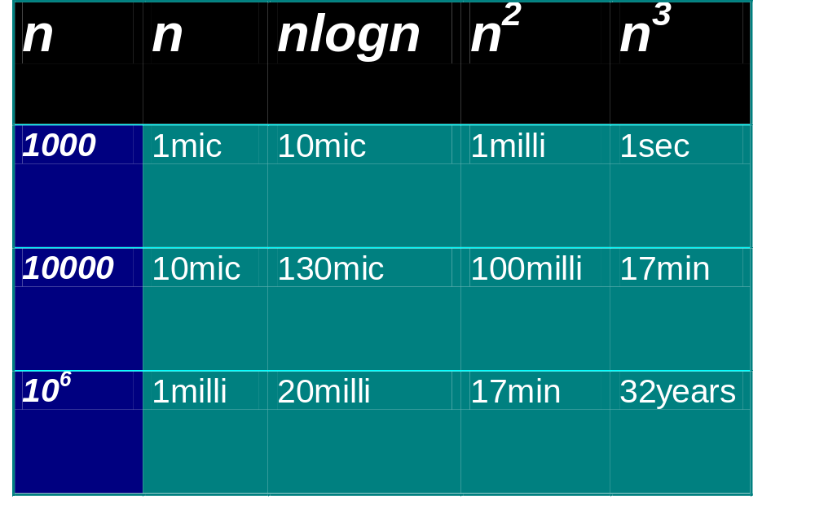
Practical Complexities
10⁹ instructions/second
Notes:
Teraflop computer the 32yr time becomes approx 10 days.

Slide 57
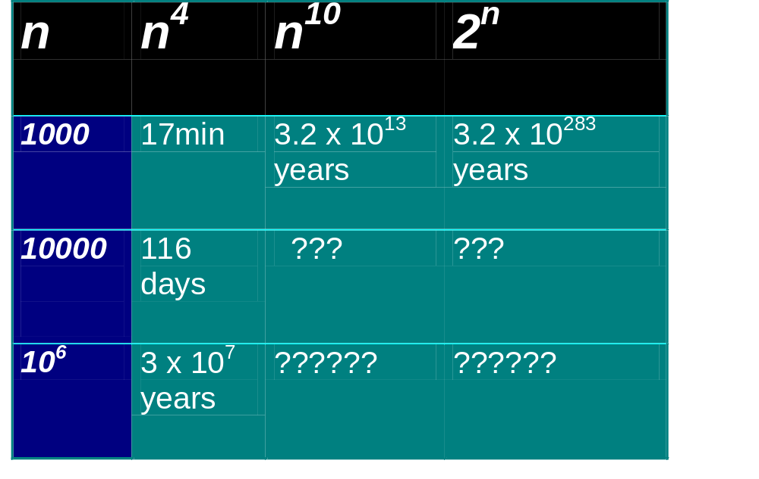
Impractical Complexities
10⁹ instructions/second

Slide 58
Homework
What is the running time of Merge-Sort if the array is already sorted? What is the best case running time of Merge-Sort? Justify the answer.

